Slide 1
UHV-I Session 2 Exploring our Aspirations and Concerns
Planning for a fulfilling life by relating
academic success, career… expectations of family, peers…
to our basic aspiration…

Slide 2
Interaction Before Main Session
Hear from participants about their exploration from previous day(s)
Q&A
Place some expected conclusions, find out if they also came to these/similar conclusions

Slide 3
Home Assignments
1.1. Get to know as many of your batch mates as you can! You should be able to introduce at least 5 of them in detail.
1.2. Make a list of your
Aspirations (चाहना)
You may like to include the expectations (अपेक्षा) of your family, friends and hopes (आशा) the nation has from you
Concerns (चिंता), or problems (समस्याएं)
To be written in your UHV-I Notebook. We will discuss further in the next session
Aspirations | Concerns/Problems

Slide 4
UHV-I Session 2 Exploring our Aspirations and Concerns
Planning for a fulfilling life by relating
academic success, career… expectations of family, peers…
to our basic aspiration…

Slide 5
Your Aspirations and Concerns
Aspirations | Concerns/Problems
To do well in college | Tension, peer pressure
Happiness in the family | Anger, not much time for family
Notes:
Aspiration = Desire (could be motivated by PC, S or NA)
Concern/Problem = what comes in the way of achieving our aspirations, and we want to get rid of them

Slide 6
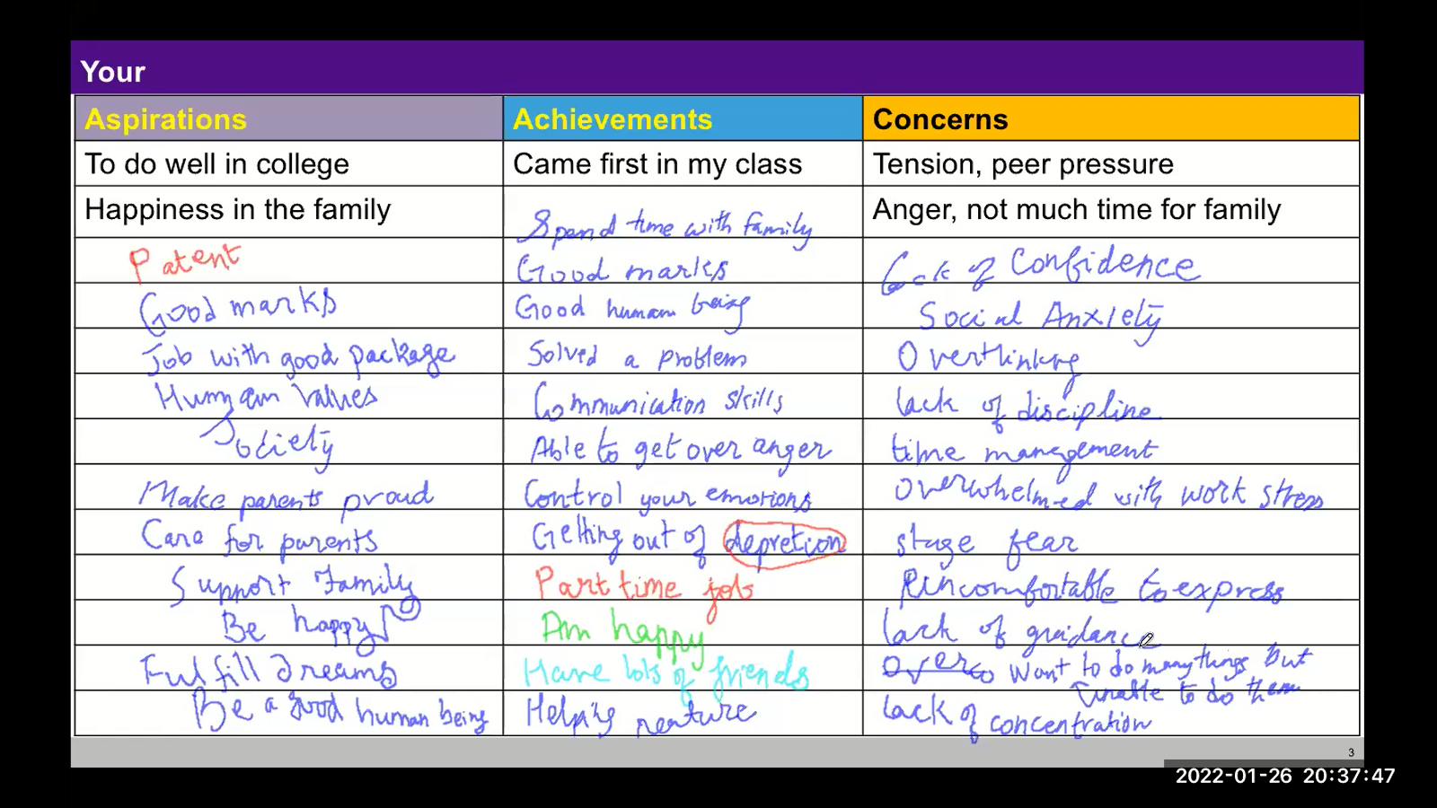
Your Aspirations and Concerns (sample)
Notes:
From 26 Jan 2022 eSIP Followup Session by Arjun

Slide 7
We want to live a fulfilling life… We are making effort for it
Make a list of all the efforts you are making
to fulfil your aspirations and to resolve your concerns/problems
e.g.,
I am studying hard… so that I get a degree… so that…
I do what my mother wants… to express my respect to her… so that…
I am saving my pocket money… to buy a mobile for my brother… so that…
I am smoking, playing video games… to get attention… so that…

Slide 8

Evaluation of Effort
Is your effort (प्रयास)
To understand your basic aspiration (चाहना) and fulfil them?
or
To understand the root cause of your concerns (चिंता), problems (समस्याएं)
and resolve them?
or
To escape, to run away from problems?
or
For something else?
But first, let us see if there is some basic aspiration we want to fulfill
Notes:
To escape, to run away from problems?

Slide 9
Understanding Basic Aspiration
Present Effort
(1)
Studying
Doing Internship
Attending Coaching
Doing Articleship
Doing MBA
Researching
Painting…
to Become?
(2)
an engineer
a doctor
a farmer
an artist
a teacher…
to Get/Do?
(3)
Get Money
Earn Name, Fame
Do Research, Innovation
Take care of parents
Make family/nation proud
Get Power in society
Earn Respect…
to Be?
(4)
To be happy and prosperous
In continuity!
Why?
Why?
Why?
Basic aspiration
Which one is your basic aspiration (1, 2, 3 or 4)?
Can you see that your basic aspiration is to be happy and prosperous? In continuity?

Slide 10
Understanding Steps, Ways to fulfil Basic Aspiration
Present Effort
(1)
Studying
Doing Internship
Attending Coaching
Doing Articleship
Doing MBA
Researching
Painting…
to Become?
(2)
an engineer
a doctor
a farmer
an artist
a teacher…
to Get/Do?
(3)
Get Money
Earn Name, Fame
Do Research, Innovation
Take care of parents
Make family/nation proud
Get Power in society
Earn Respect…
to Be?
(4)
To be happy and prosperous
In continuity!
Why?
Why?
Why?
These may be steps, ways to filfill basic aspiration
Basic Aspiration
Then, what are these other things?
Can you see that becoming something, doing something, getting something etc.
may be just the steps to achieve your basic aspiration?
Would you like to make sure that the steps definitely add up to fulfil your basic aspiration?

Slide 11
How Would you Plan Your Life to Fulfil Your Basic Aspiration?
?
??
???
Present Effort
(1)
to Become
(2)
to Get/Do
(3)
to Be
(4) To be happy and prosperous
In continuity!
Plan with effort, steps at the base
Understand basic aspiration and plan the effort with that clarity
Basic Aspiration
How would you like to plan your life?
1-2-3-4: Plan the steps without being clear about your basic aspiration?
or
4-3-2-1: Develop clarity of your basic aspiration (4) and then work out the steps?
How are you going about your life now?
Is the present program working for you?

Slide 12
Only one way of Fulfilling basic aspiration? Or Multiple ways?
Now that we can distinguish between basic aspiration and the steps, ways to fulfill them, find out
what would be appropriate if your “favourite” way is closed?
Be unhappy, depressed… try to escape from unhappiness, become inactive…?
Find an alternate way, and make effort for it?
Examples:
I wanted to go to the best institute of the country for my degree, but I was forced to take admission here. My dreams are shattered
I did not get the branch of my choice. My motivation to study is gone
I did not get the roommate I wanted. I am unhappy
Present Effort
(1)
?
to Become
(2)
??
to Get/Do
(3)
???
to Be
(4)
To be happy and prosperous
In continuity!
Basic Aspiration

Slide 13
Multiple Ways to Fulfil Our Basic Aspiration
Present Effort
(1)
to Become
(2)
to Get/Do
(3)
to Be
(4)
To be happy and prosperous
In continuity!
To be happy and prosperous in continuity, there may be a definite program, which we need to explore
With that clarity, we may have multiple choices to get/do/become
And we can decide our effort accordingly
e.g., to ensure prosperity in the family, we may have multiple job options,
and various skills to learn
Basic Aspiration
We will discuss the basic requirements to be happy and prosperous in the next session

Slide 14
We can do a similar exploration for our concerns/problems
Are we working to resolve problems holistically or just seeking relief?
Is there a root cause of our problems?
Is the root cause of our problems that we are not clear about our basic aspiration and working to fulfil our basic aspiration?
We will explore these in future sessions

Slide 15
Sum Up
The basic human aspiration is for the continuity of happiness and prosperity
We are making effort to realise our aspirations
(yet, there are problems, so we are trying to resolve them also)
Essential to fulfil our basic aspiration
Understand our basic aspiration (continuous happiness and prosperity)
Understand the program to fulfil our basic aspiration
Make focused effort for it (plan the steps with clarity of our basic aspiration…)
There are multiple steps, ways to fulfil our basic aspiration
If one way is closed, we can always pick another way
In due course of time, we will find that our concerns/problems get resolved naturally
when we focus on fulfilling basic aspiration!
UHV is intended to help us with this

Slide 16
Home Assignment

Slide 17
Home Assignment
2.1. Write your conclusions / takeaways from the exploration in this session
2.2. Is your basic aspiration really happiness(सुख) and prosperity(समृद्धि)? Only sometimes or every moment?
2.3. Is your effort fulfilling your basic aspiration?
2.4. Think about some of those situations where your favourite path was closed
What did you feel, think, do in these situations?
Write down one of them in detail
To be written in your UHV-I Notebook

Slide 18
Questions?

